Slide 1
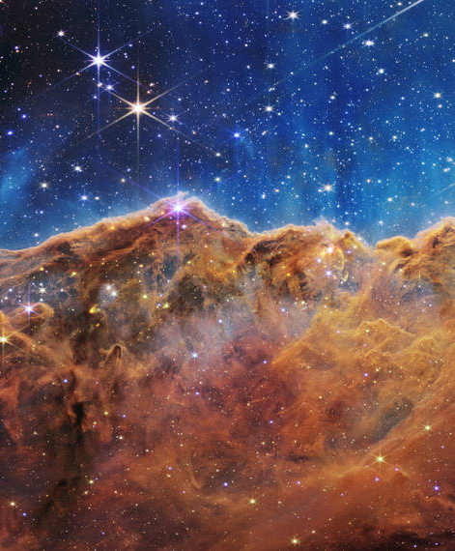



Double Copy in Curved Spacetimes
Mariana Carrillo González

Slide 2
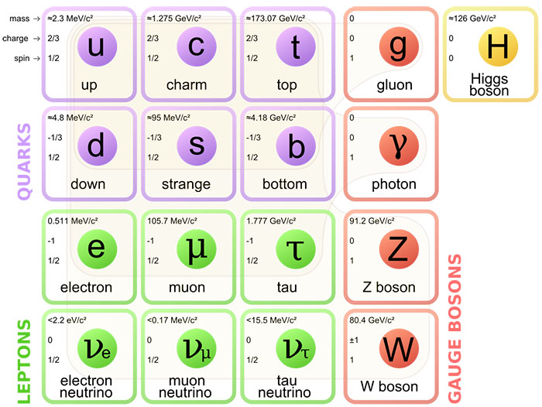
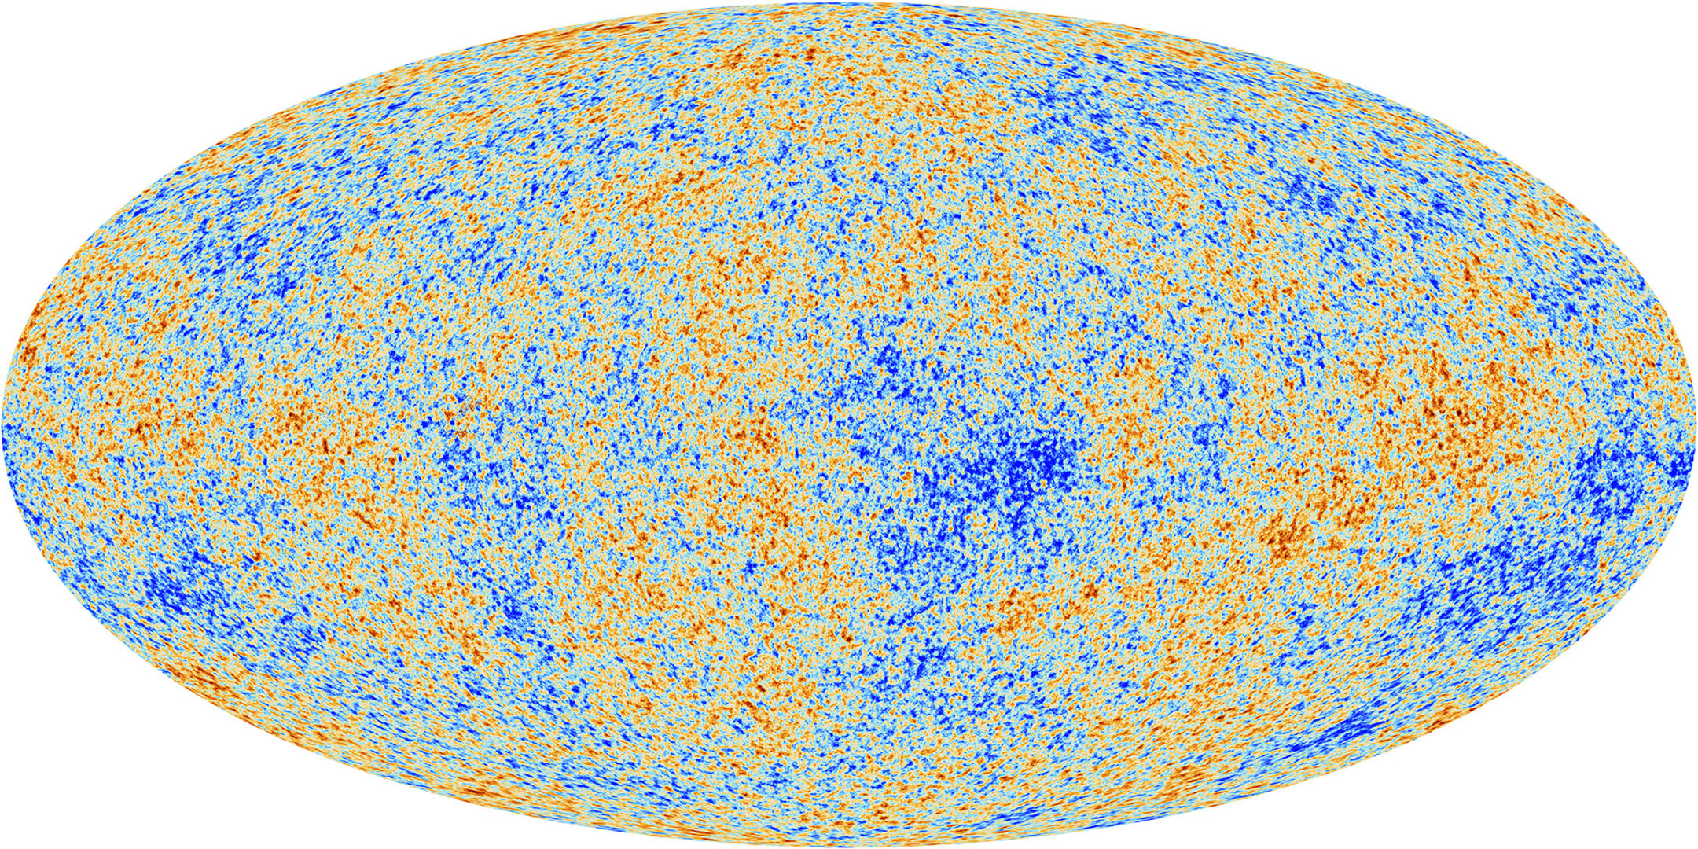
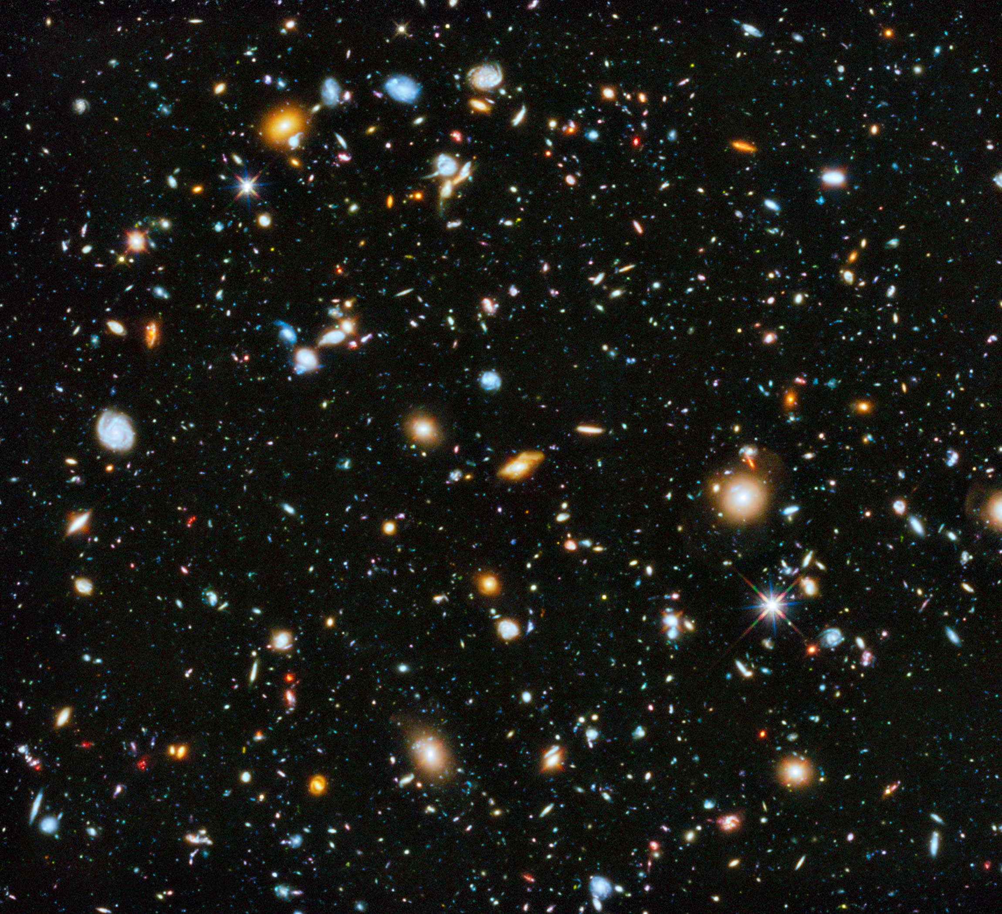
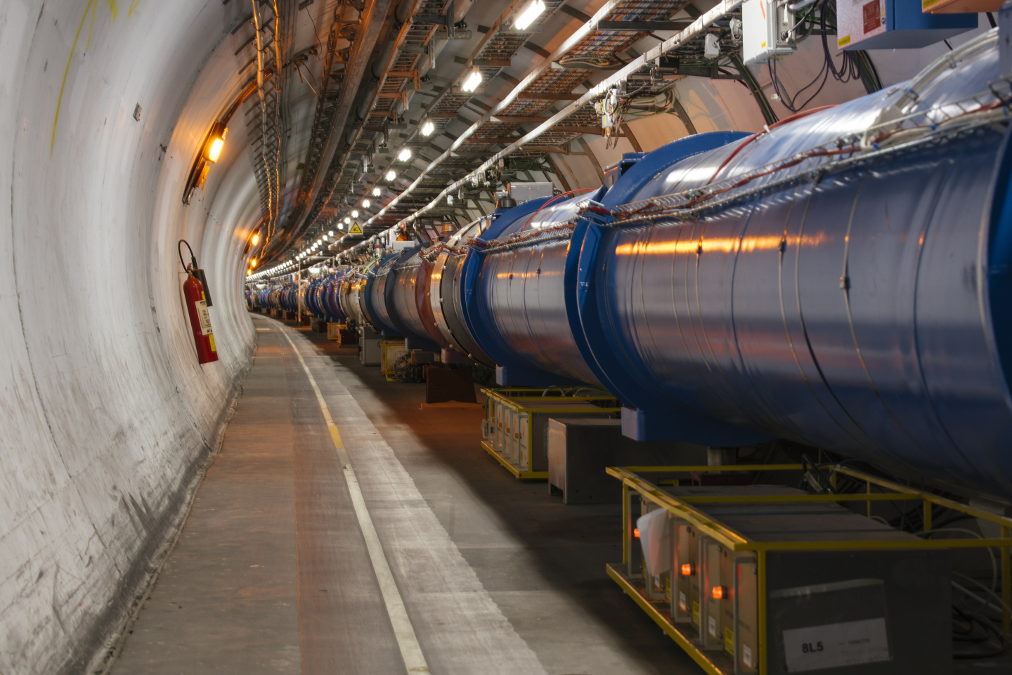
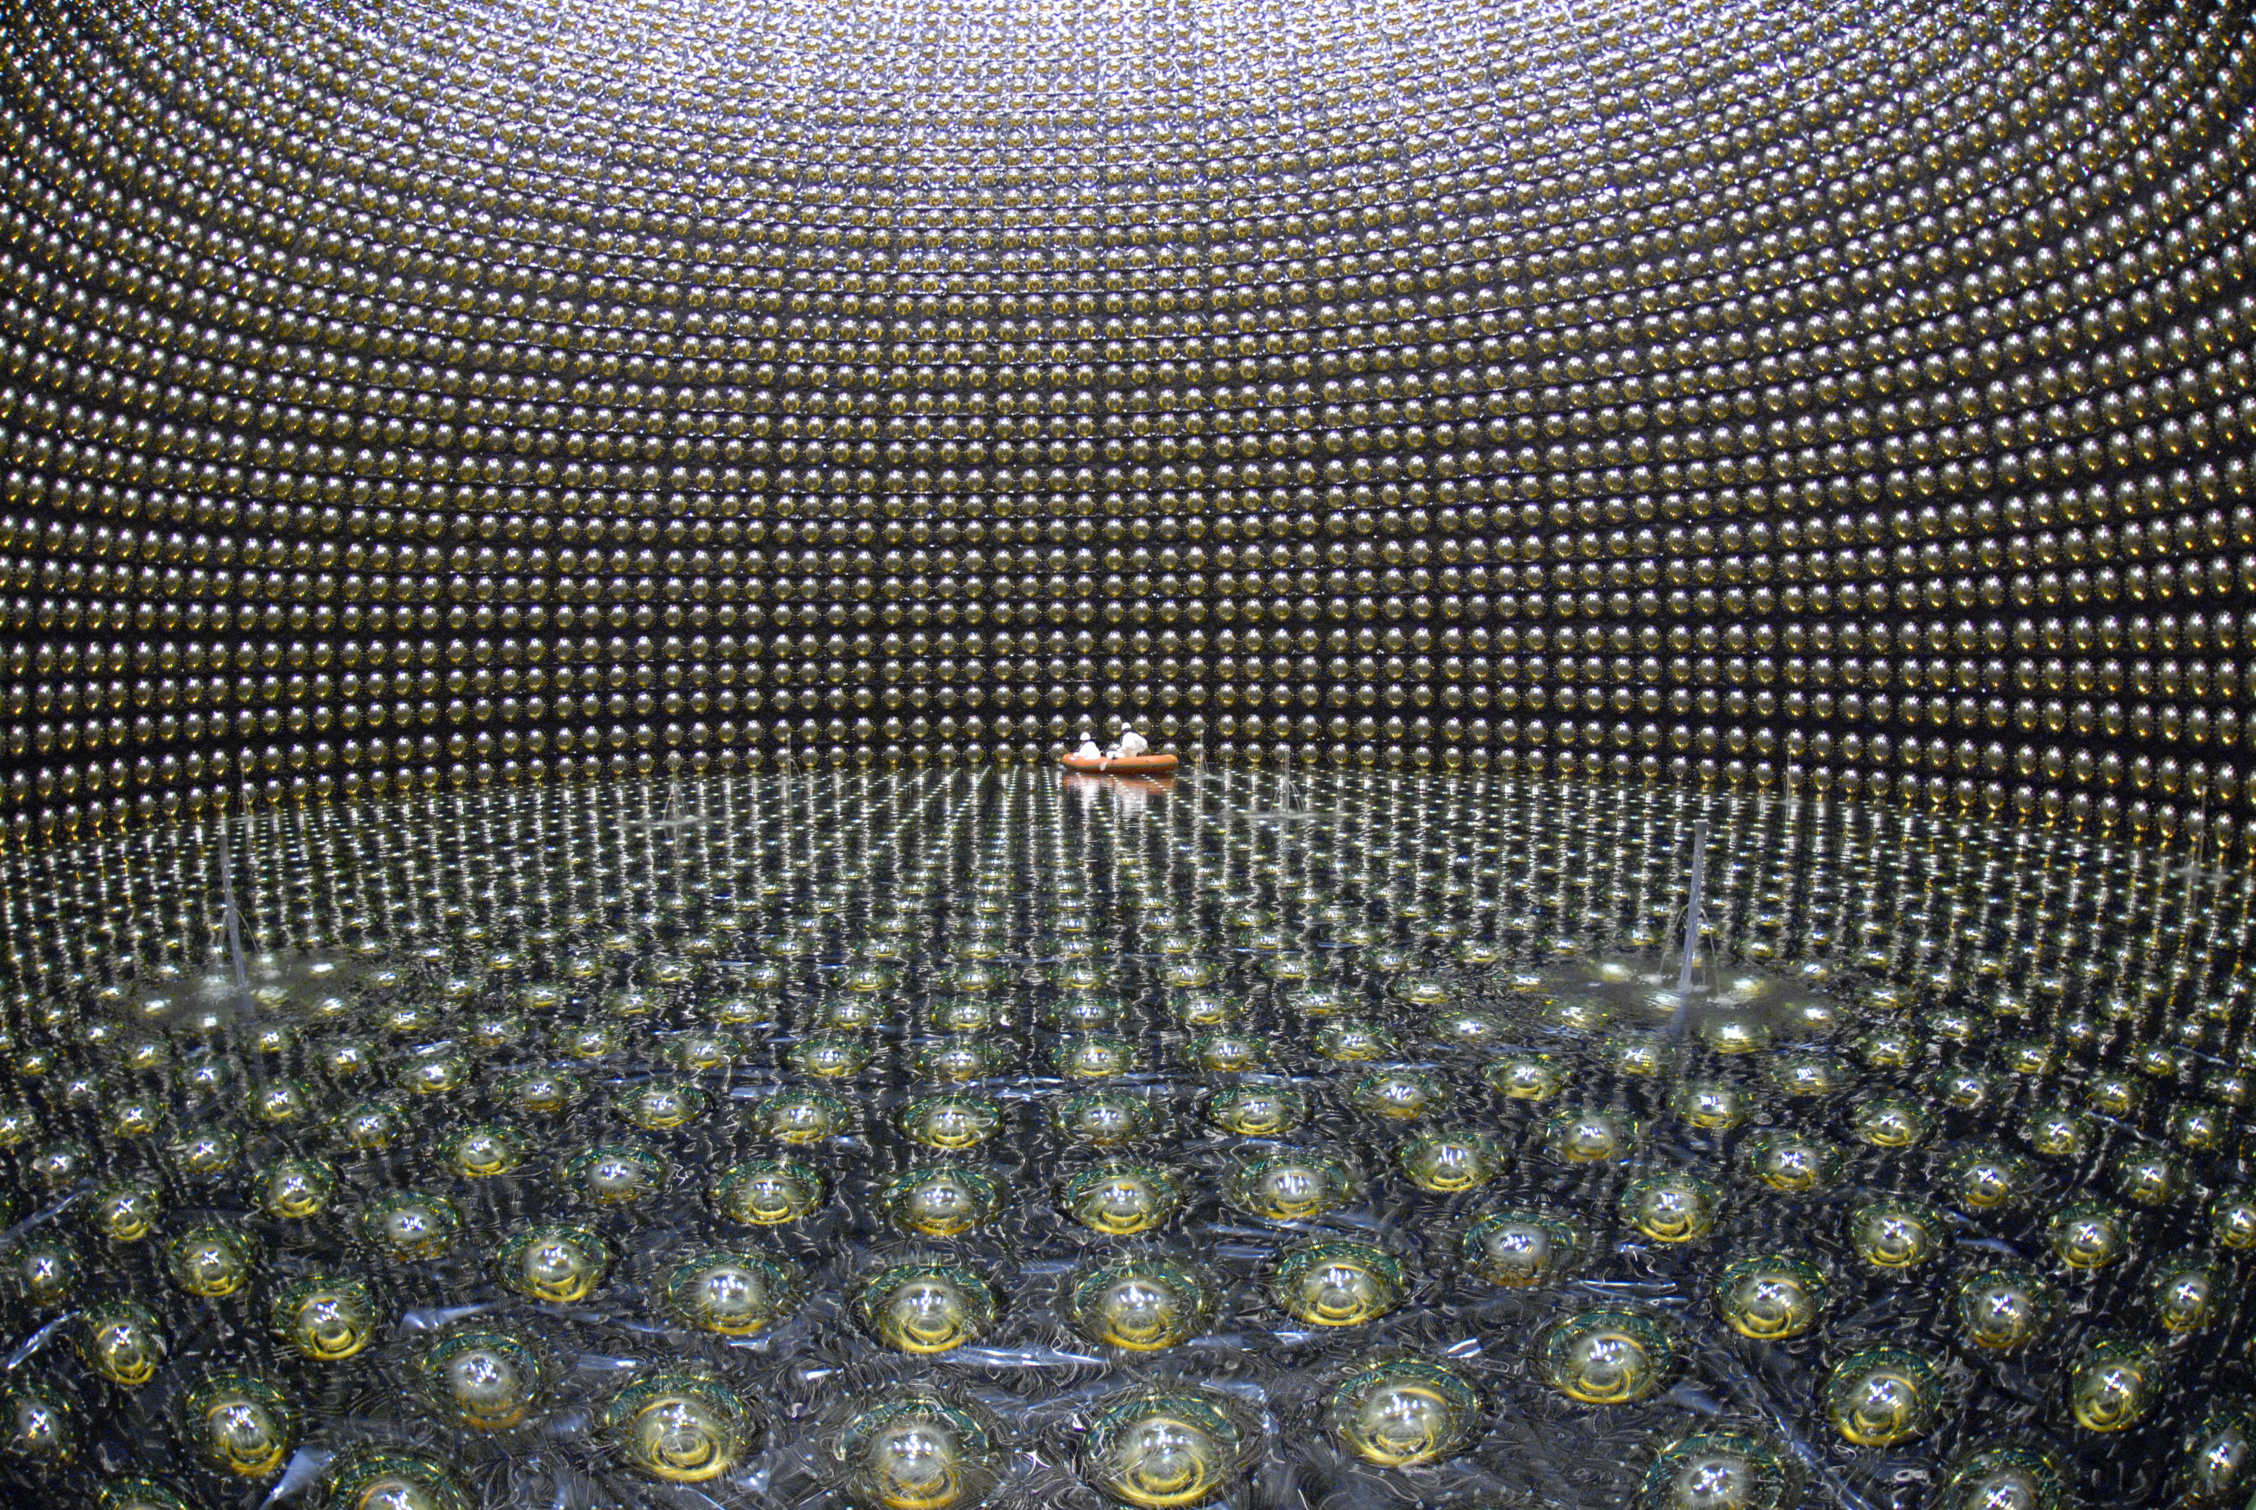
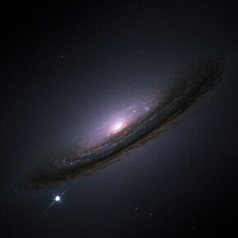
Standard Models: Particle Physics vs Cosmology

Slide 3
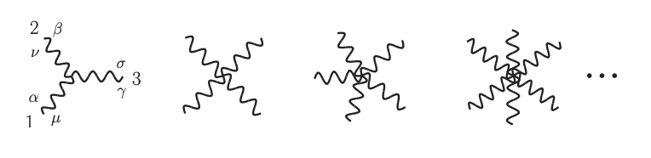
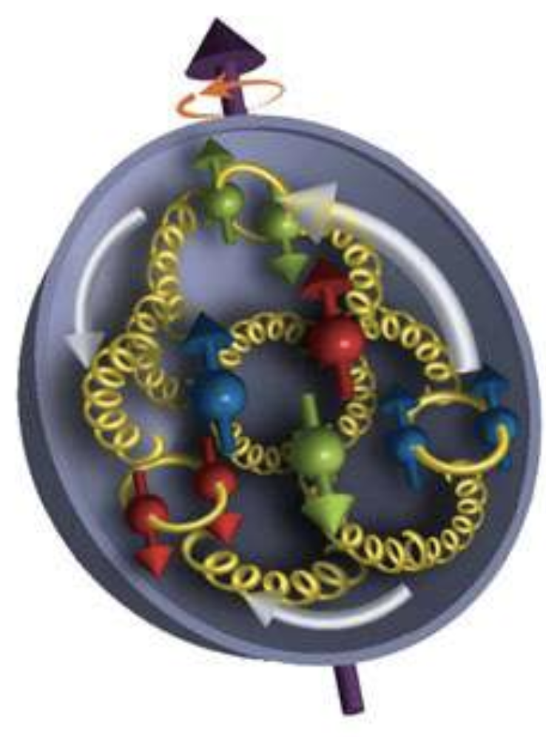
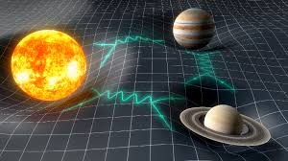
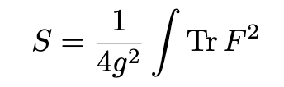
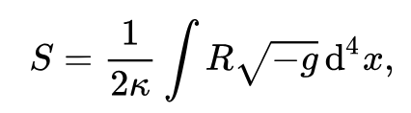
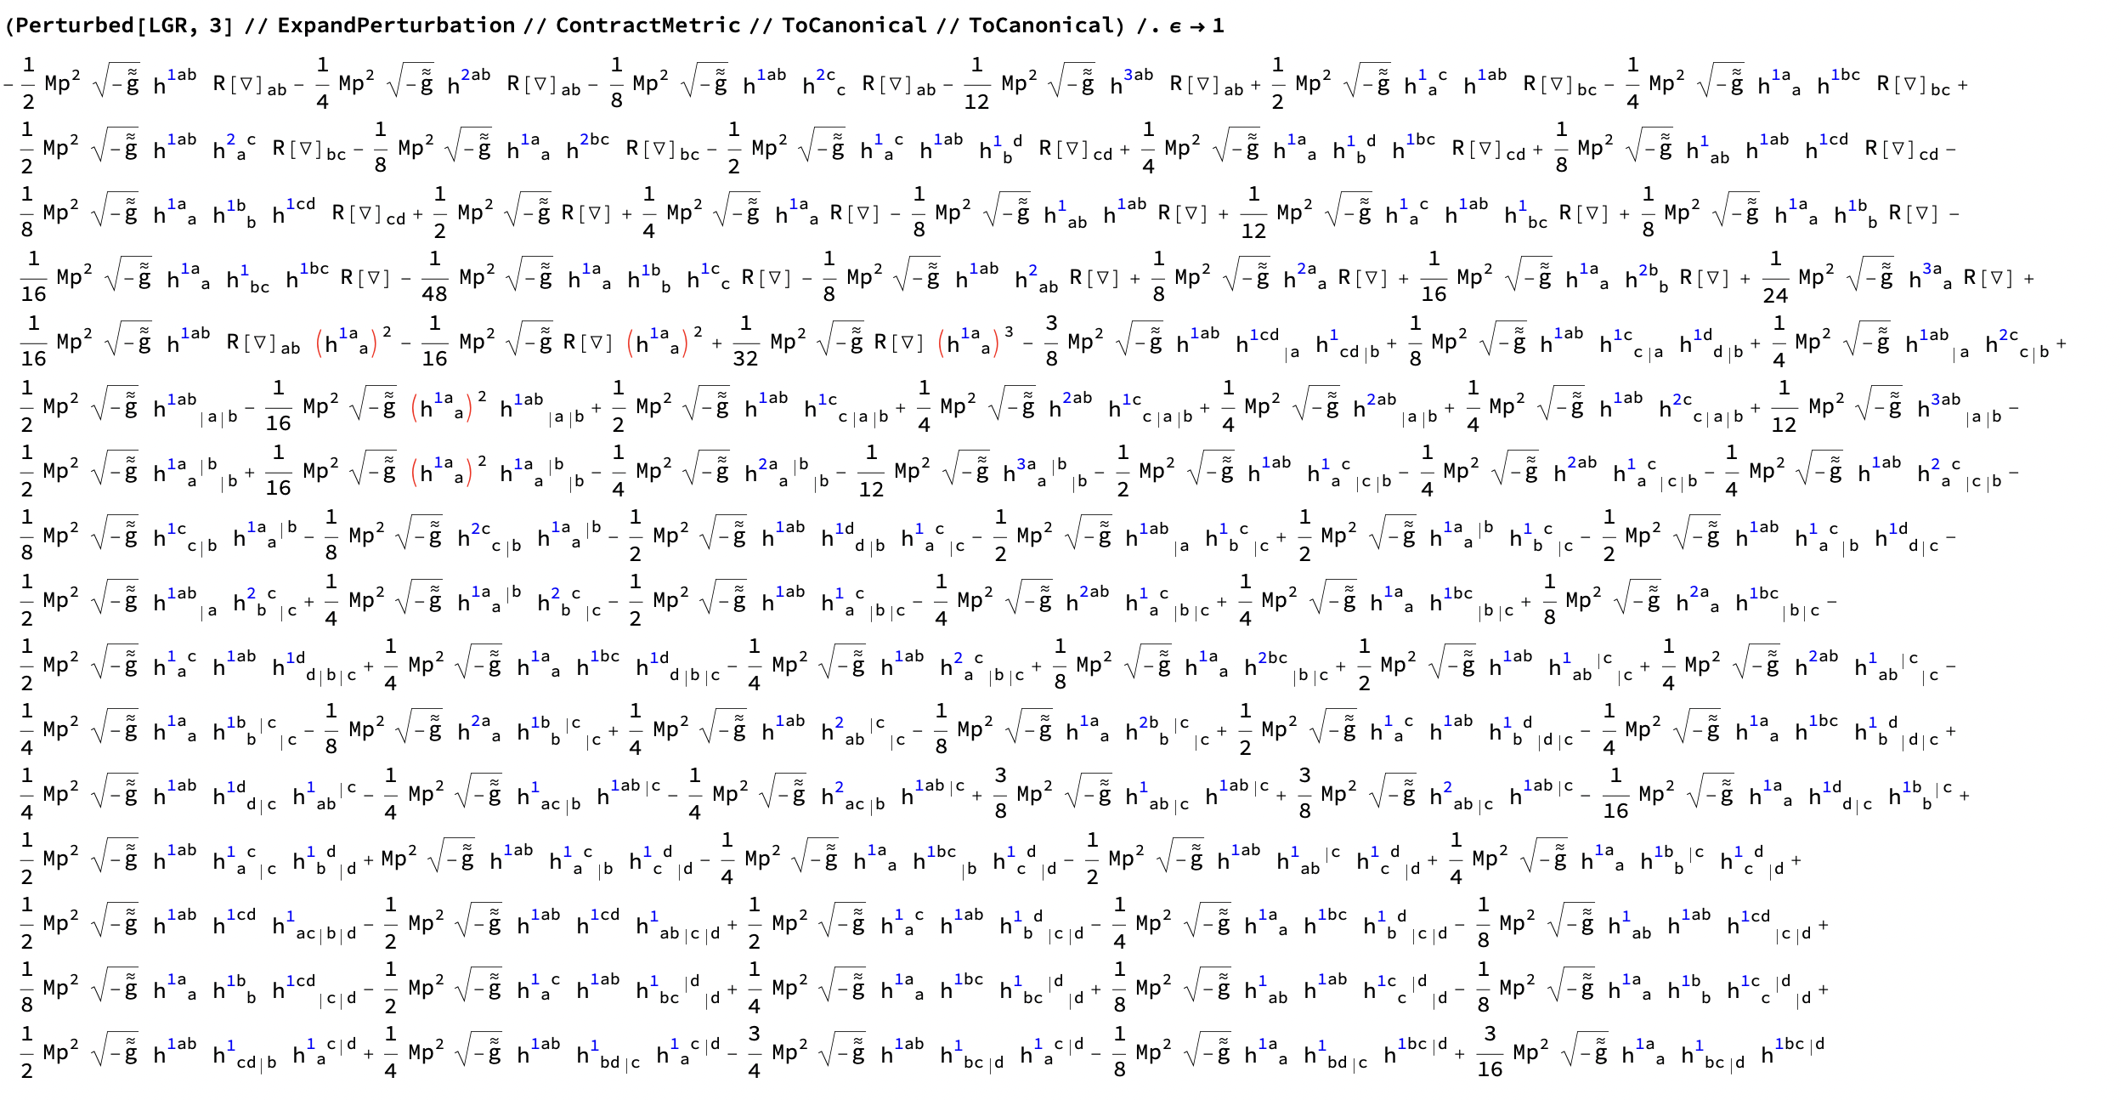
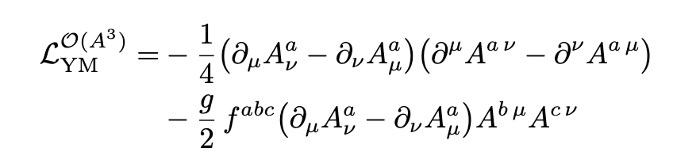
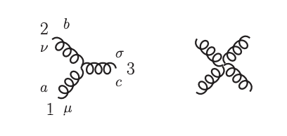
Lessons from flat space
Is there a better description?
Gauge theories
Gravity
Is there a better description?

Slide 4


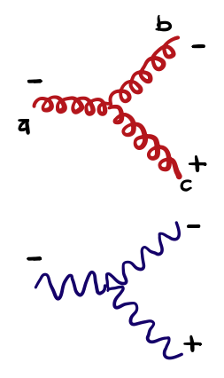




Better variables in flat space: spinor-helicity
Use different representations of the Lorentz group
Identity + Pauli matrices
Massless
$$p^{2}=E^{2}+p_{3}.p_{3}=m^{2}=0$$
On-shell helicity amplitudes
Rotations in 3d

Slide 5
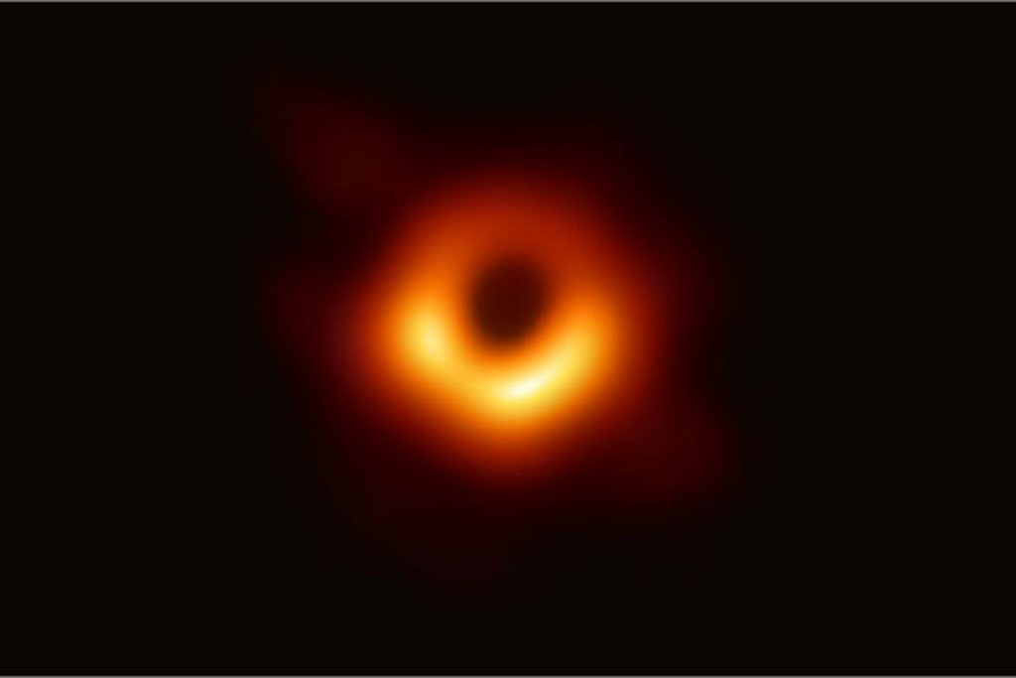
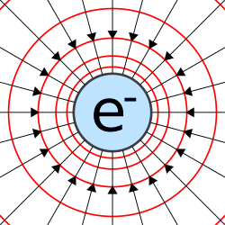
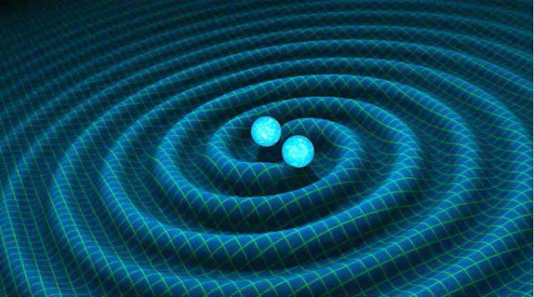
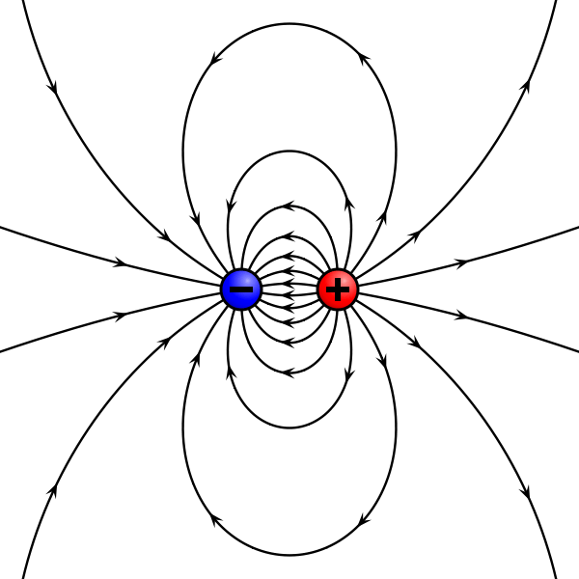
Gravity is simpler than it seems
Black hole
electric charge
electric charge
A black hole can be seen as the double copy of a charge

Slide 6

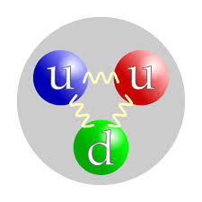





More precisely:
A black hole in a flat spacetime can be seen as the double copy of a colored charge
Proton
kinematics $×$ kinematics
color $×$ kinematics
color $×$ kinematics
$$\sim$$
color algebra: internal symmetries
kinematic algebra: local symmetries
color $−$ kinematics duality

Slide 7
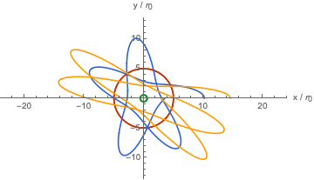
What do we learn from the double copy?
Amplitudes
Breakdown of gravity EFT (divergences in loops)
Precision calculations for gravitational waves
Hidden symmetries
Curved space correlators
Breakdown of gravity EFT
Precision calculations of cosmological correlators
Hidden symmetries
Exact solutions and eom
New gravitational solutions
On-shell symmetries of the theory
Lagrangian and action
Simplified Feynman rules
Off-shell symmetries of the theory

Slide 8
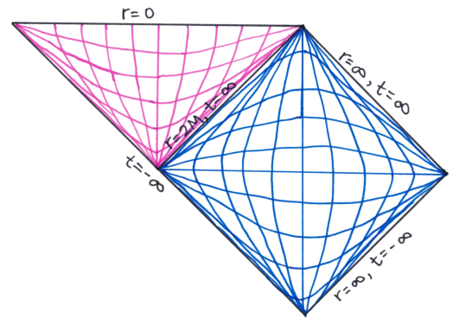
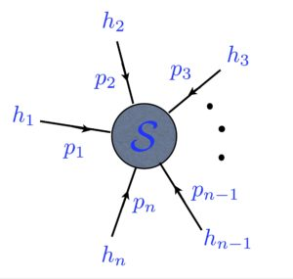
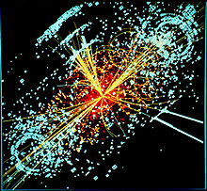
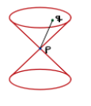
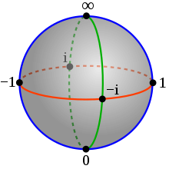

Double copy in different spaces
Inverse Fourier transform
Coordinate space: classical solutions + eom
Twistor space
Momentum space: Amplitudes
Penrose transform
Half- Inverse Fourier transform

Slide 9
Scattering amplitudes and correlators
Momentum space

Slide 10
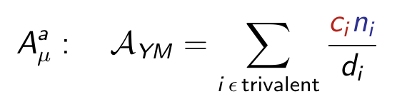


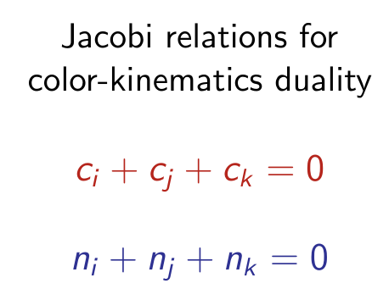
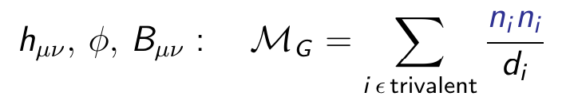
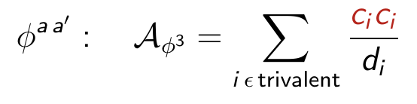

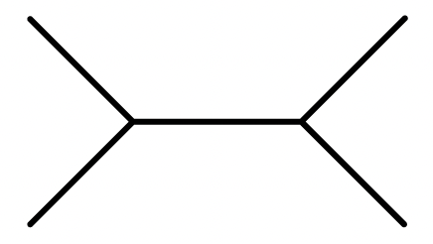


BCJ double copy & color-kinematics duality
Bern, Carrasco, Johansson
Jacobi relations
$$d_{i}$$
Contact term
Trivalent graph

Slide 11
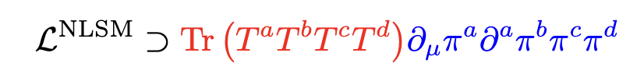

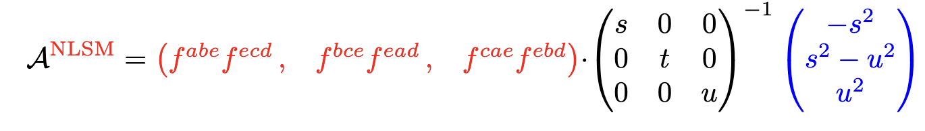
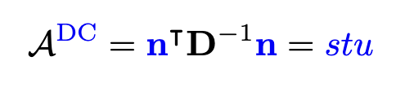
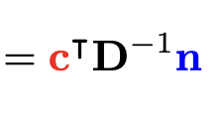
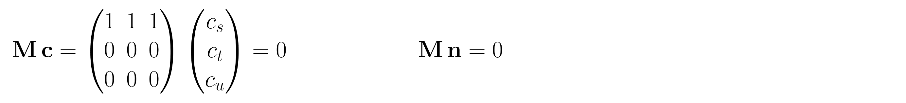
4-point double copy: NLSM to Special Galileon
NLSM
Special Galileon
single-copy amplitude
double-copy amplitude
double copy
Color-kinematics duality

Slide 12
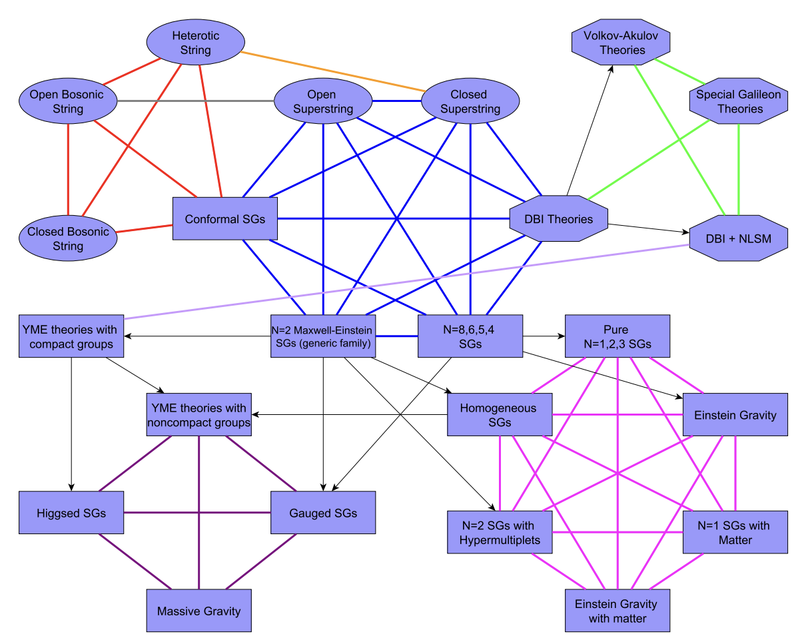
Web of amplitude relations
Diagram from
SAGEX 2203.13013

Slide 13
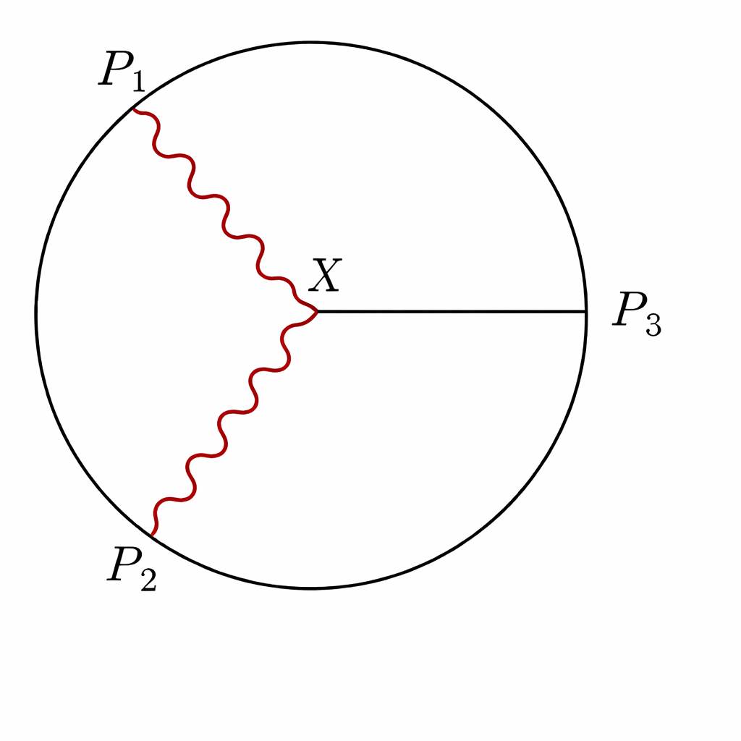
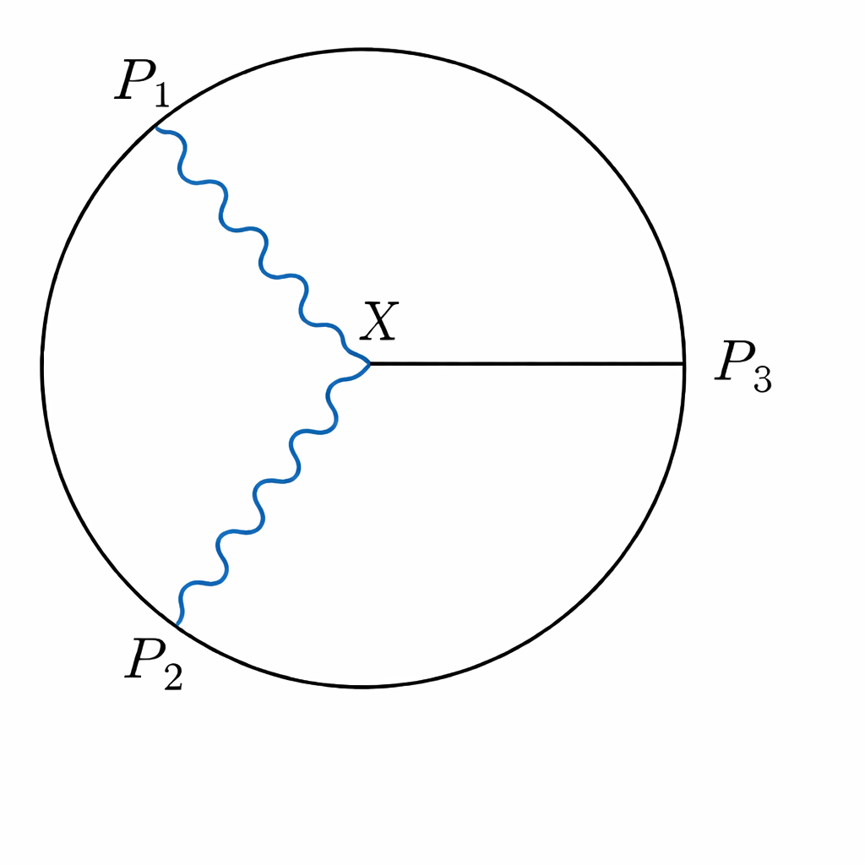
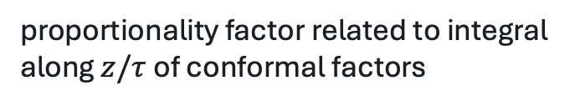
Double copy for momentum-space (A)dS correlators
Farrow, Lipstein, McFadden
proportionality factor related to integral along $z/τ$ of conformal factors
Color-kinematics duality can be formulated but BCJ double copy fails at 4-points
Kinematic numerators have poles
Double copy can also be formulated via cosmological dressing rules
Chowdhury, Jazayeri, Lipstein, Marshall, Mei, Sachs
Notes:
[Sources]
- Uploaded PDF: DoubleCopyCurvedSpacetimes-10.pdf. Pages 24-25, Eqs. (99)-(106).

Slide 14
Correlators
Mellin space

Slide 15
Double copy for correlators in Mellin space
Zhou; Drummond, Glew, Santagata
4-point ${AdS}_{5}$ double copy can be formulated in Mellin space as
N=4 supergravity = ${\text{(}\text{N}\text{=2 }\text{super} \text{Yang}\text{−}\text{Mills}\text{)}}^{2}$
Mellin transform: $x → Δ, s,t, u related to conformal dimensions$
Notes:
[Sources]
- Uploaded PDF: DoubleCopyCurvedSpacetimes-10.pdf. Pages 24-25, Eqs. (99)-(106).

Slide 16
Classical solutions
Coordinate space

Slide 17

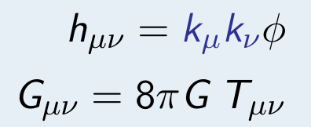
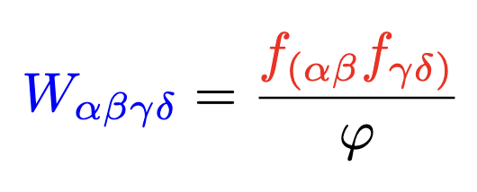
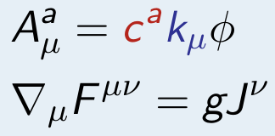
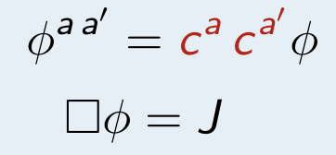

Kerr-Schild double copy
Weyl/Cotton double copy
Monteiro, O’Connell, White
Luna, Monteiro, Nicholson, O’Connell
KS metric:
Linearizes Einstein’s equations
Curvatures
4d Weyl and 3d Cotton
MCG, Momeni, Rumbutis
Emond, Moynihan
$$\sim$$
Black holes and gravitational waves in Minkowski and (A)dS

Slide 18
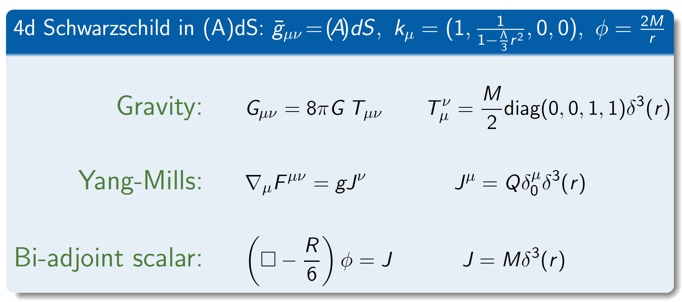
Simplest example: non-rotating black hole
MCG, Penco, Trodden; Bahjat-Abbas, Luna, White

Slide 19
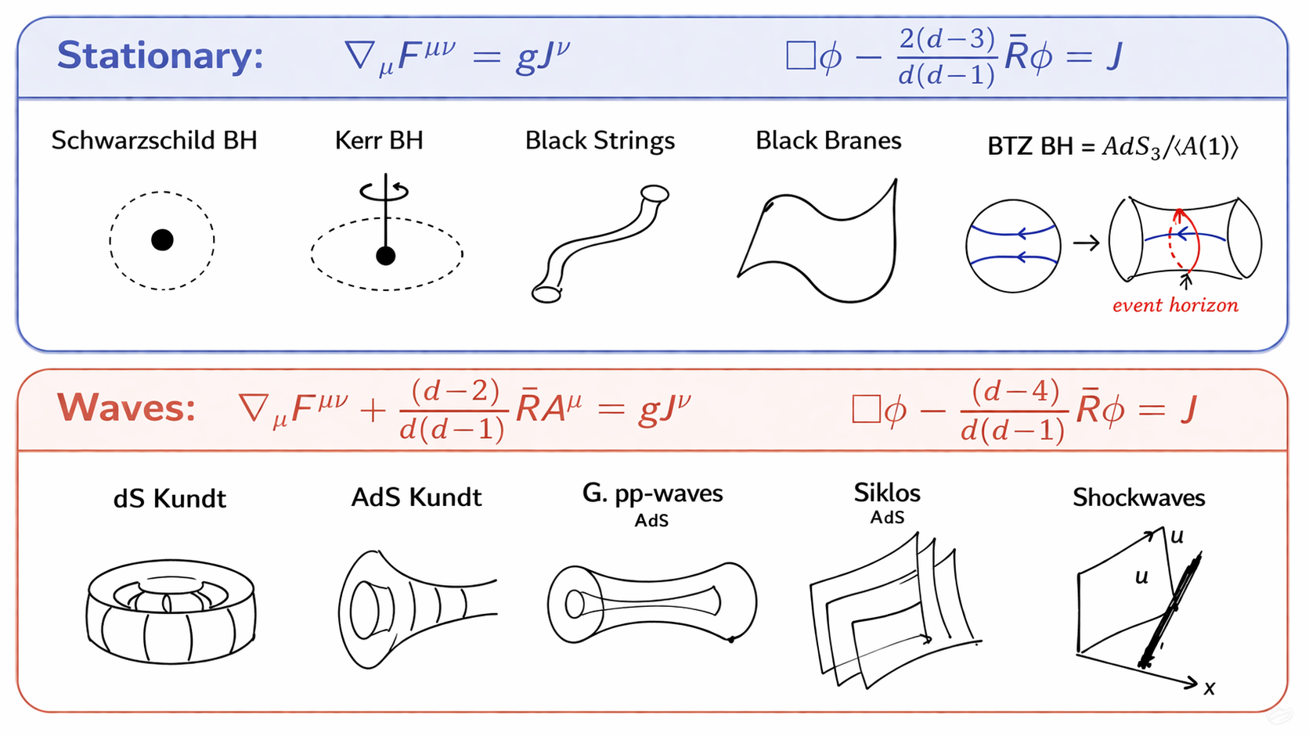
MCG, Penco, Trodden

Slide 20
Lagrangians of self-dual sectors
Coordinate space

Slide 21

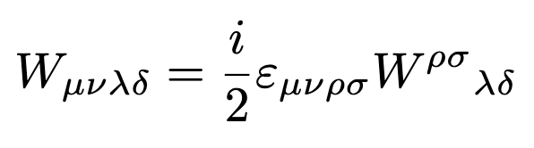
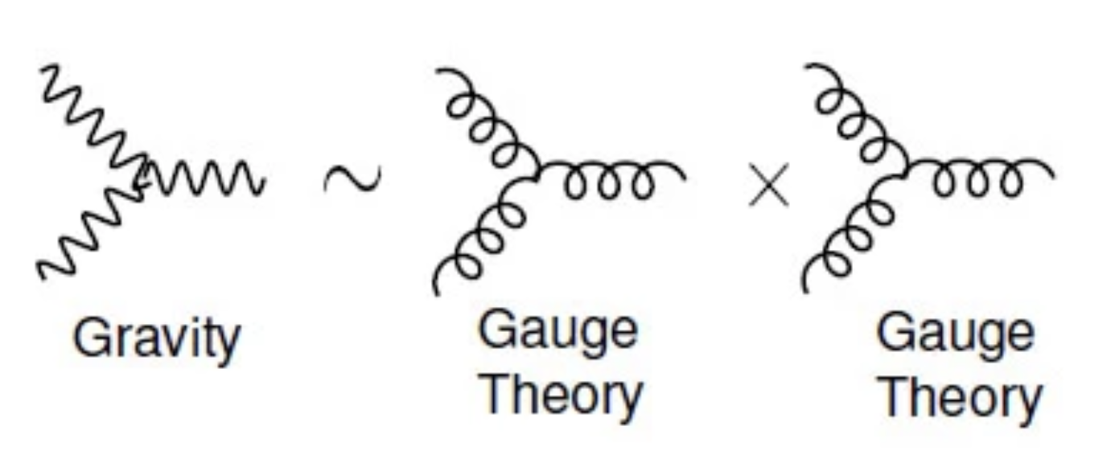

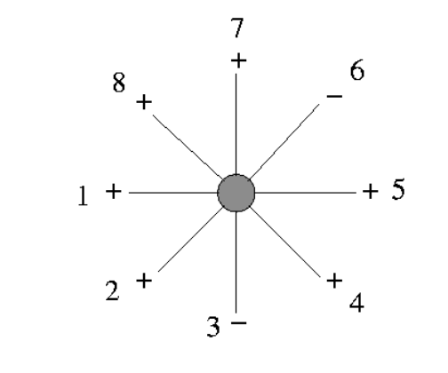

Cosmological Subsectors: Self-Dual Gravity
Only 3 particle interactions and one helicity mode
Naturally arise in twistors space and are classically integrable
Full theory as perturbations from SD sector
$→$1st order = MHV amplitudes
0
tree-level amplitudes

Slide 22







Cosmological Subsectors: Self-Dual Gravity
Monteiro, O’Connell
MCG, Lipstein, Nagy
Flat metric
Cosmological metric
Poisson bracket
Jacobi bracket
Double Copy: $\left[ \right]→\{ \}$

Slide 23
Amplitudes, correlators, and classical solutions
Twistor space

Slide 24









From momentum to twistor space
Witten
Half- Inverse Fourier transform
$$Z∼r Z, Z∈{ℂℙ}_{3}$$
$$λ∼rλ, \tilde{λ}∼\frac{1}{r}\tilde{λ}$$
$$A(Z=\left(λ_{α},μ^{\dot{α}}\right))$$
$μ^{\dot{α}}=x^{α\dot{α} }$ $λ_{α}$
$$μ∼rμ, \tilde{λ}∼\frac{1}{r}\tilde{λ}$$

Slide 25








From twistor to position space
$$A\left(rZ\right)=r^{−2s−2}A(Z)$$
Cech cohomology rep.
Isomorphism:
Penrose transform
Double copy
eom of anti-self-dual spin s fields
(C.D. White)

Slide 26


Twistor Double Copy

Slide 27








${\left(A\right)dS}_{4} (Ambi−)$Twistor space
Complexification of variables used in
(Baumann, Mathys, Pimentel, Rost)
Boundary limit
(MCG, Keseman)

Slide 28




2-point correlators
(MCG, Keseman)
Bulk: self-dual /anti-self-dual
Boundary: conserved currents

Slide 29





3-point boundary correlators
(MCG, Keseman)
$F^{3}$, $W^{3}$
YM, GR
Double copy
Complexification of results in (Baumann, Mathys, Pimentel, Rost)

Slide 30



Double copy in different spaces
Inverse Fourier transform
Coordinate space: classical solutions + eom
Twistor space:
Amplitudes/Correlators and classical solutions
Momentum space: Amplitudes/Correlators
Penrose transform
Half- Inverse Fourier transform
DC in curved space review coming soon

